Slide 1
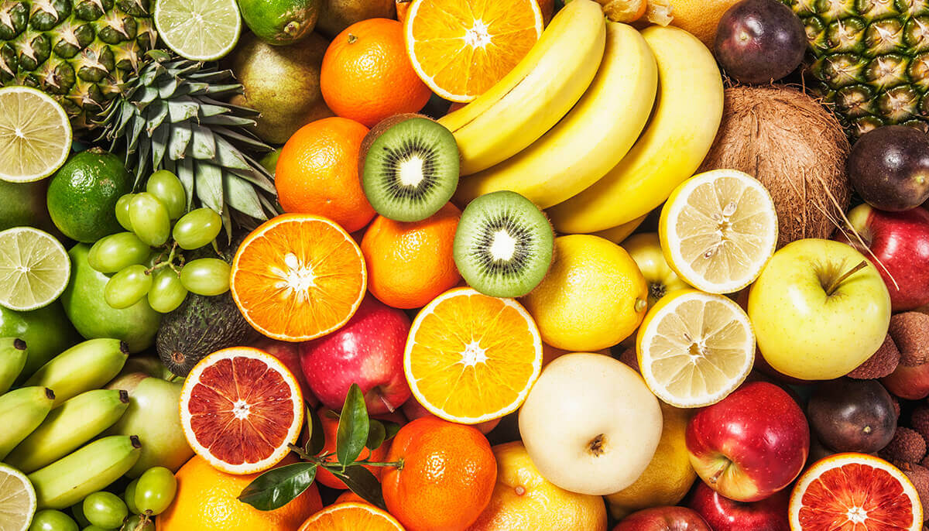
FRIPE
A Fruit Ripeness Detection App
BY: JinGee Kim, TaekJung Kim, JunYoung Yoon, and Jihoo Kim
ADVISED BY: PROF. DESMOND YAU-CHAT TSOI

Slide 2
Problems
Artificial ripening
Limitations of human senses
Implausible solutions for consumers

Slide 3
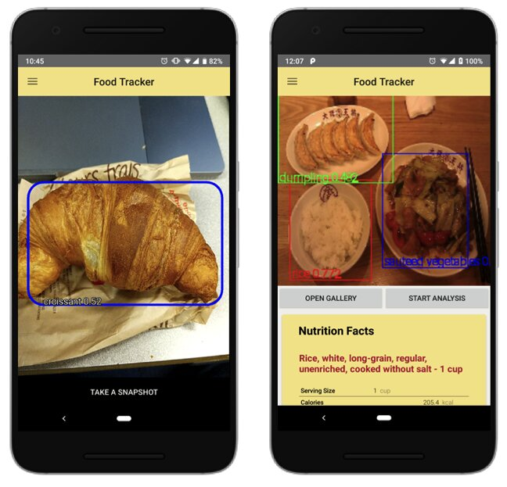
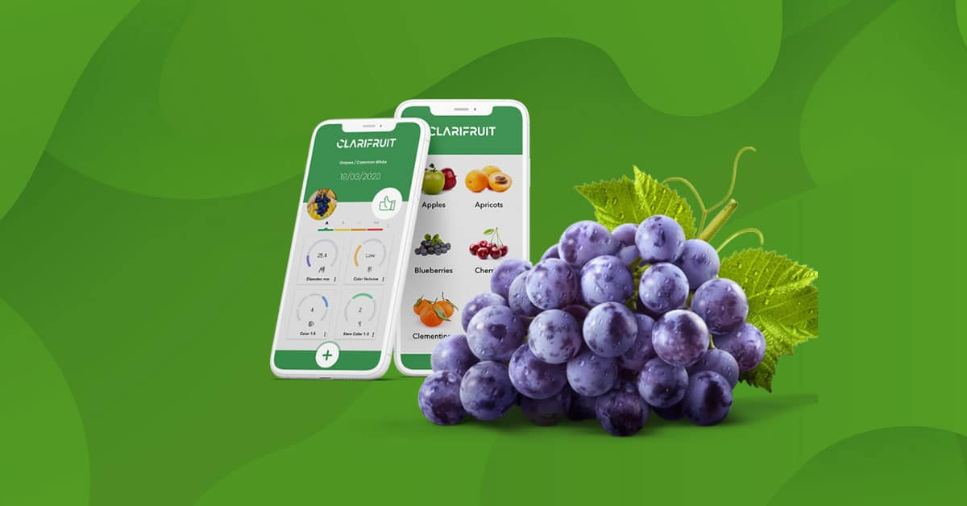
Existing Solutions

Slide 4
OBJECTives
Accurately Identify Fruits in real-time
Precisely Calculate the Ripeness of a fruit
Provide a User-Friendly Interface with an optimized User-Experience

Slide 5
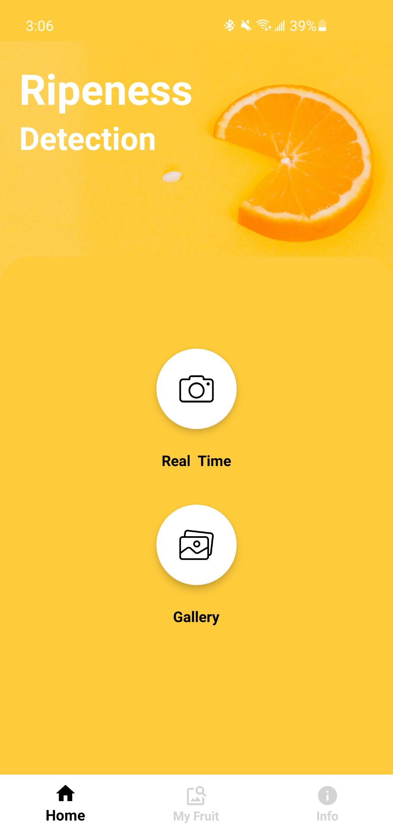


Project design
MOBILE APPLICATION
SERVER
RIPENESS CLASSIFICATION MODEL
FRUIT DETECTION MODEL

Slide 6
METHODOLOGY

Slide 7
Object
detection model

Slide 8
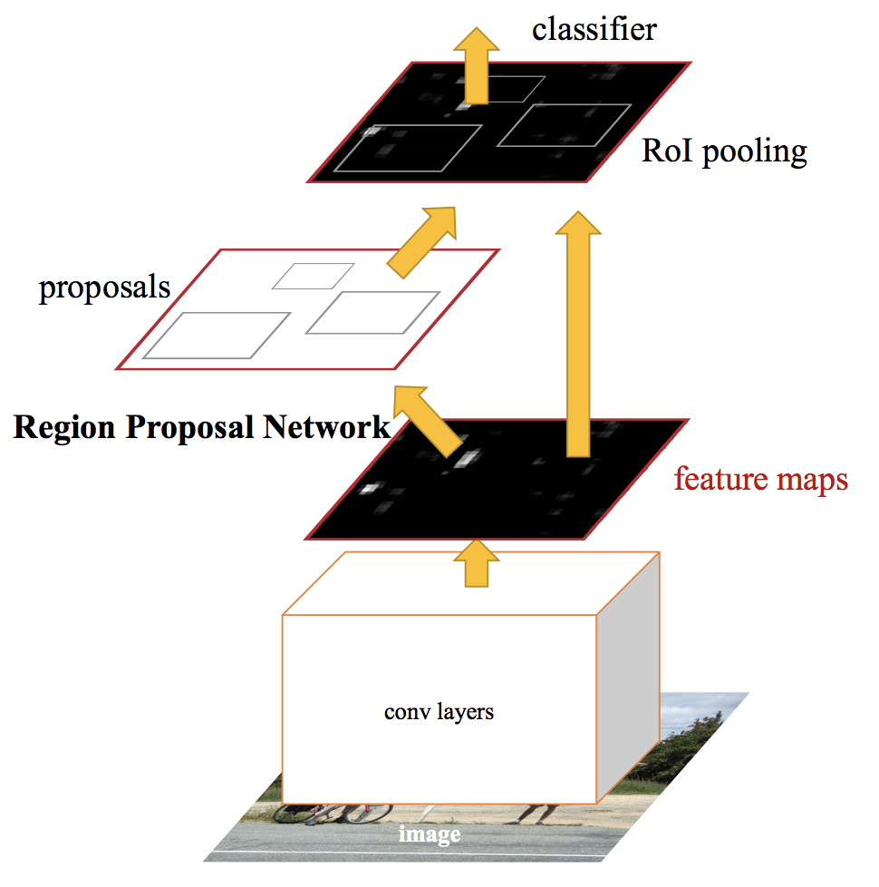
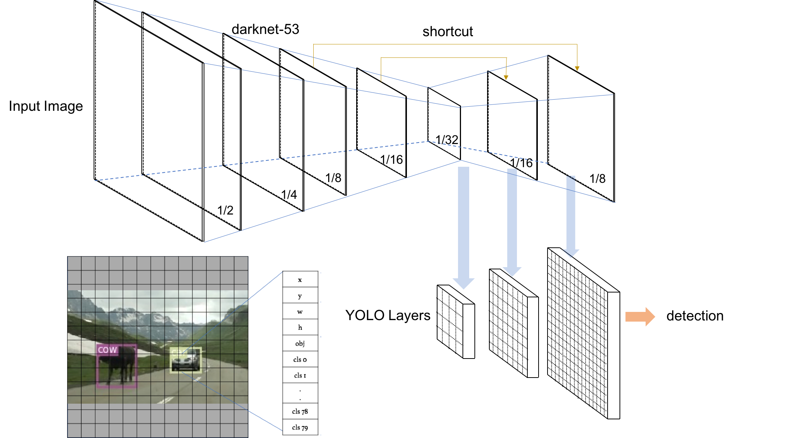
OBJECT detection
Fast SPEED and High ACCURACY
Regional Based
Fully Convolutional
Two step approach
High accuracy
Slow speed
Single step approach
Lower accuracy
Fast speed
Notes:
“Faster R-CNN: Towards Real-Time Object Detection with Region Proposal Networks,” IEEE Xplore. [Online]. Available: https://ieeexplore.ieee.org/document/7485869. [Accessed: 09-May-2021].
H. Honda, “Reproducing training performance OF Yolov3 In pytorch (part1),” 10-Jul-2019. [Online]. Available: https://medium.com/@hirotoschwert/reproducing-training-performance-of-yolov3-in-pytorch-part1-620140ad71d3. [Accessed: 09-May-2021].

Slide 9
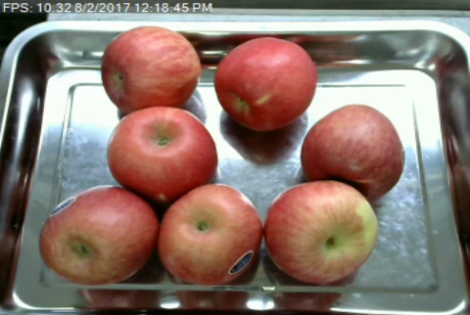
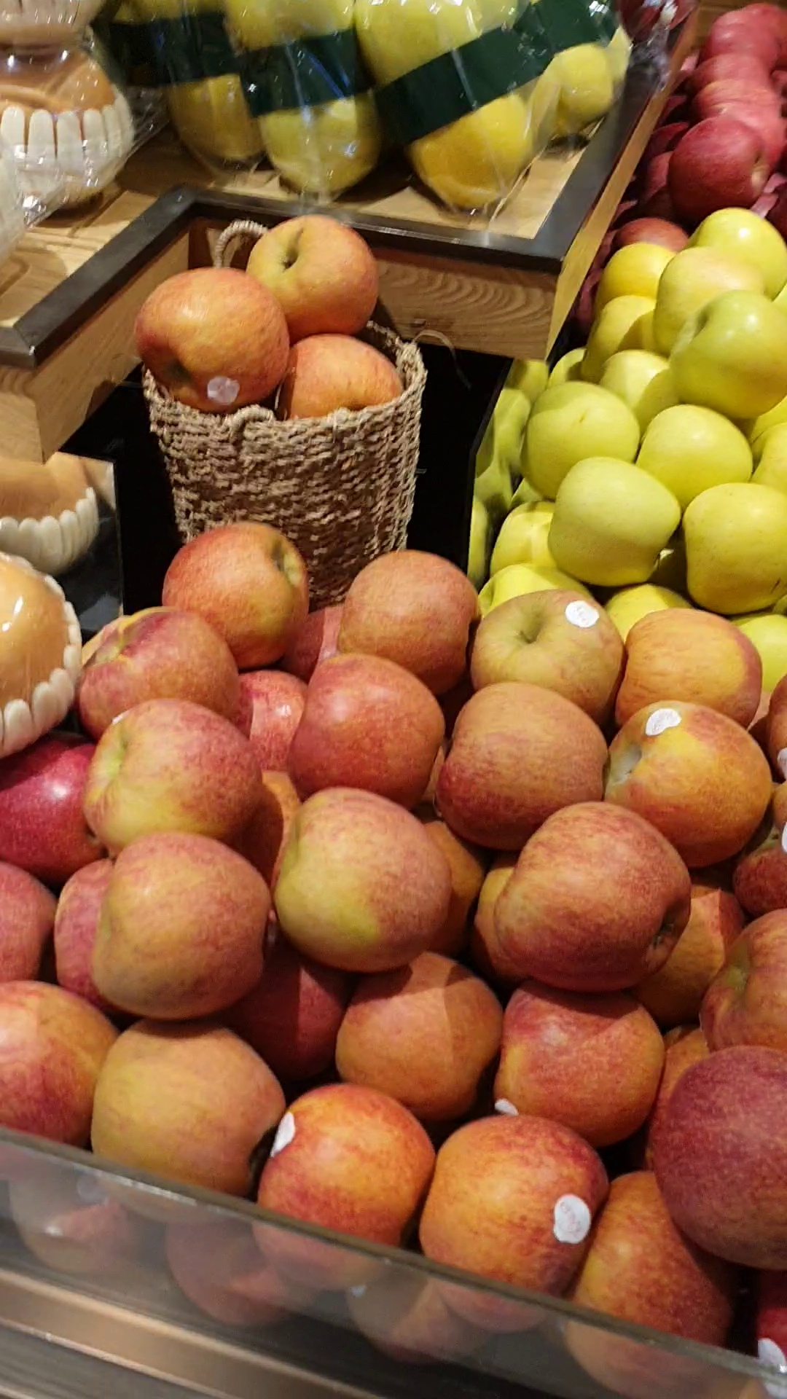
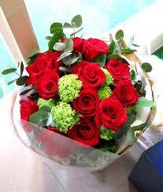
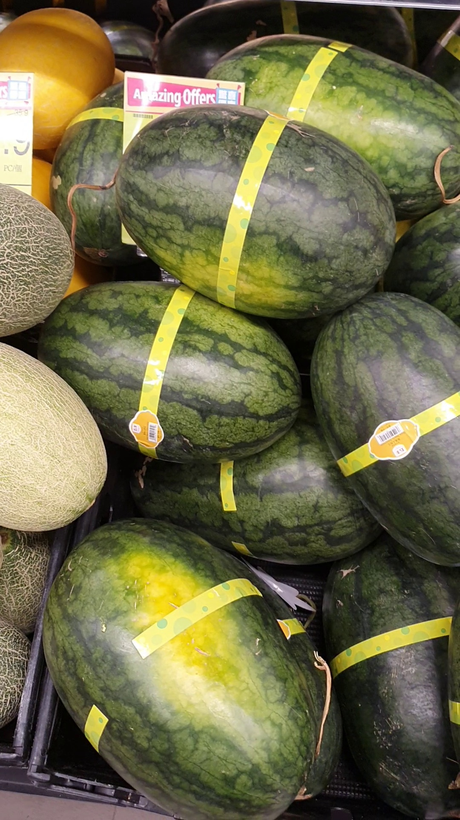
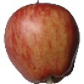
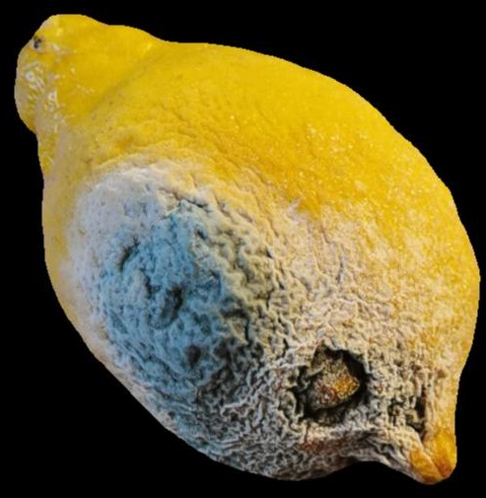
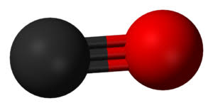
OBJECT detection - data collection / Annotation
Whole dataset = 30,000 images
Various sources
Non fruit images
Abnormal fruits
Bounding box annoation
CVAT/labelImg

Slide 10
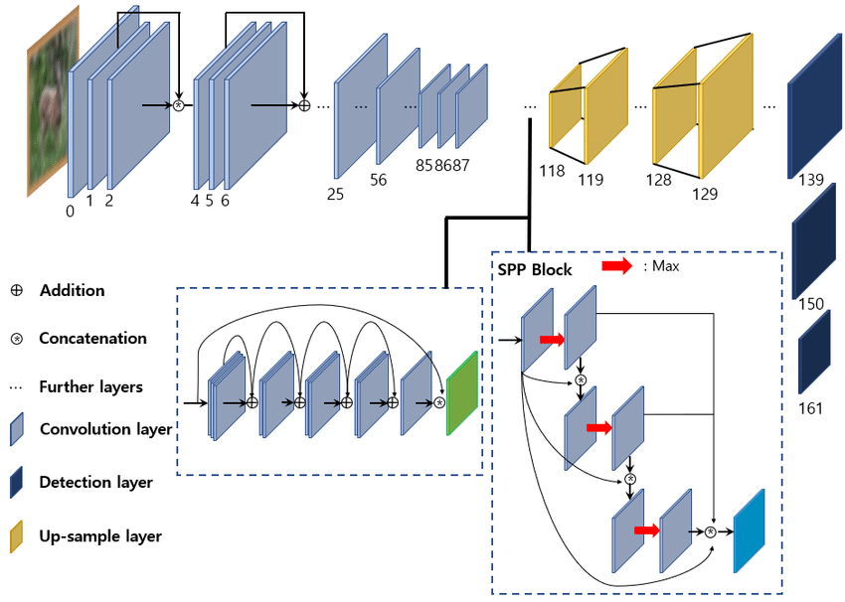
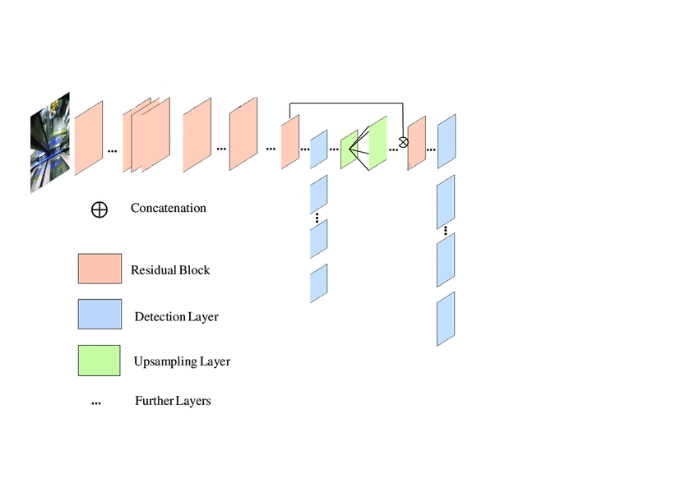
OBJECT detection - YOLO
0
81
117
119
109
115
125
YOLOv4 YOLO-fastest

Slide 11

OBJECT detection - MODel
YOLOv4 YOLO-fastest

Slide 12
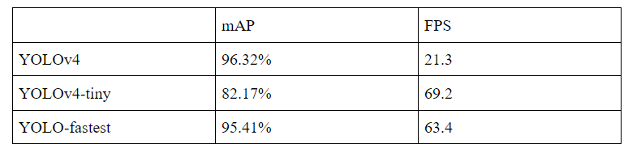
OBJECT detection - MODel
Evaluation
Mean average precision (accuracy)
Frame per second (speed)

Slide 13
Ripeness
detection model

Slide 14
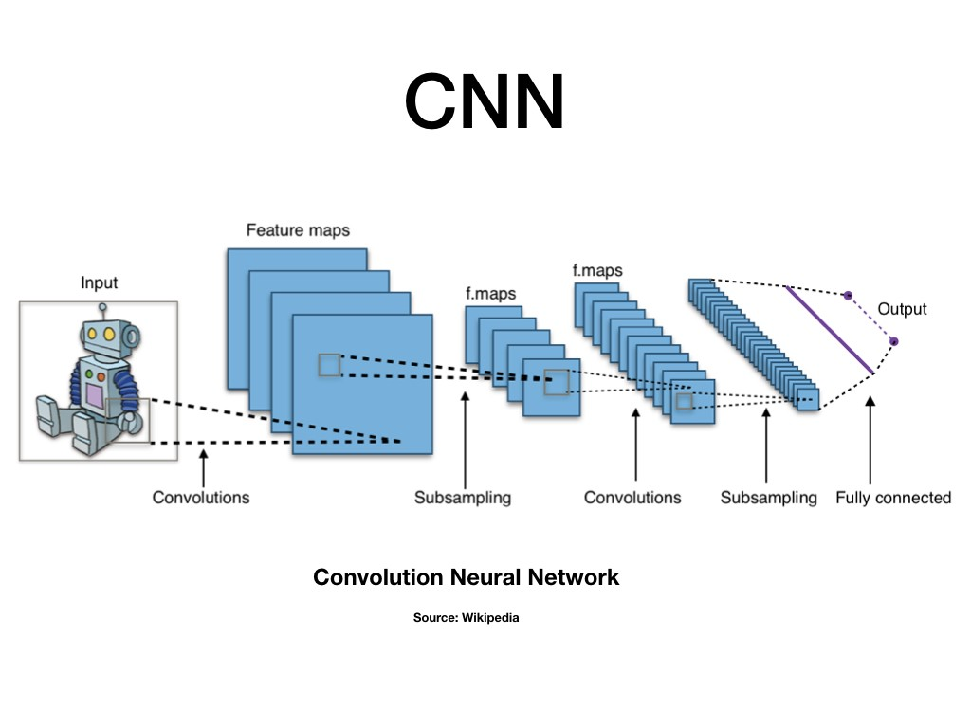
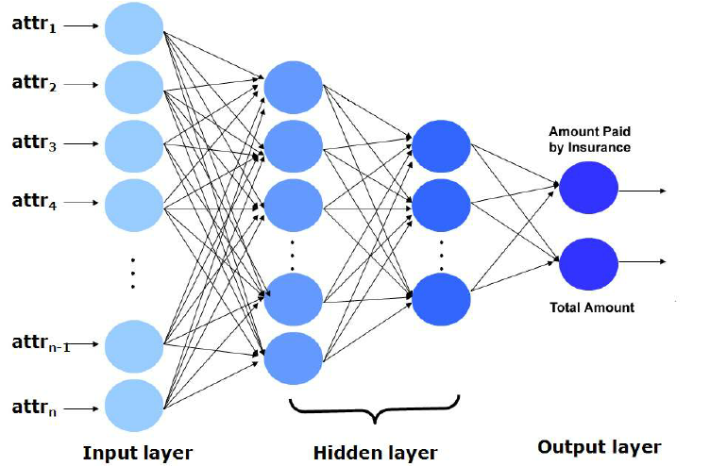
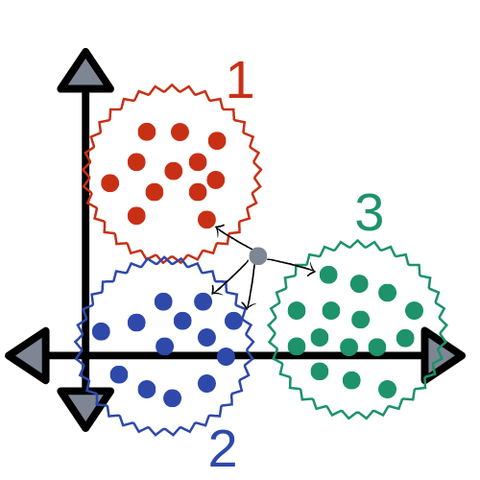
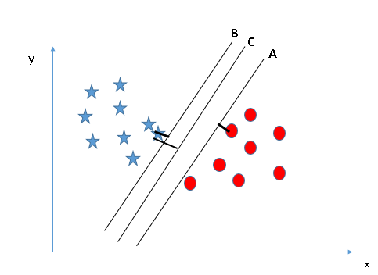
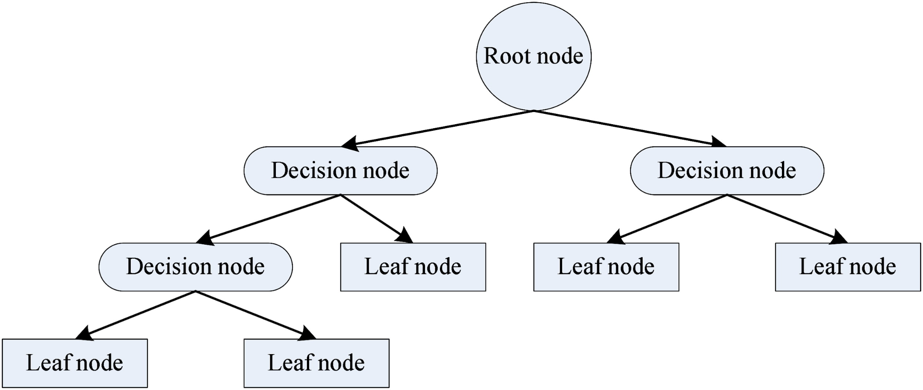
Fruit Ripeness Model
= Image Classification Model
Machine Learning Algorithms
Neural Net
Classifier

Slide 15
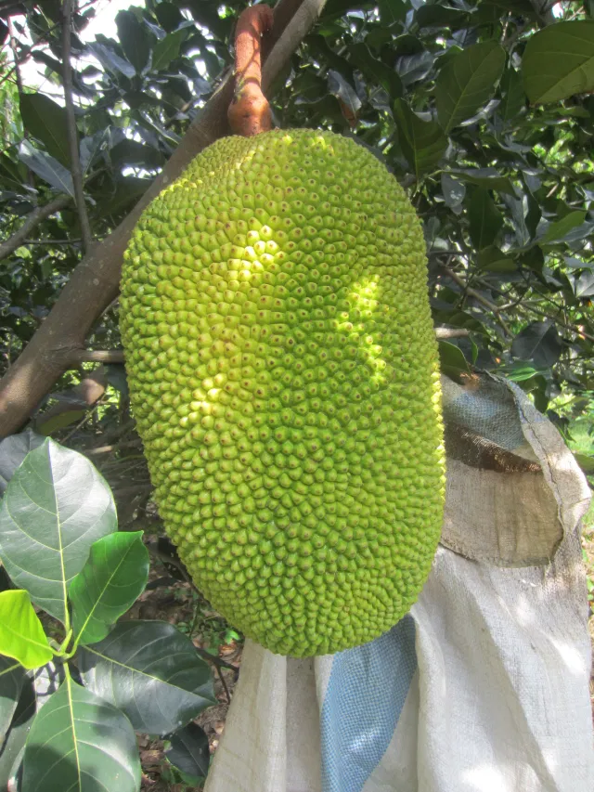
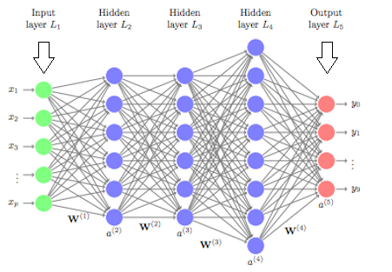
ANN model vs CNN Model
ANN MODEL
Fully connected layers

Slide 16
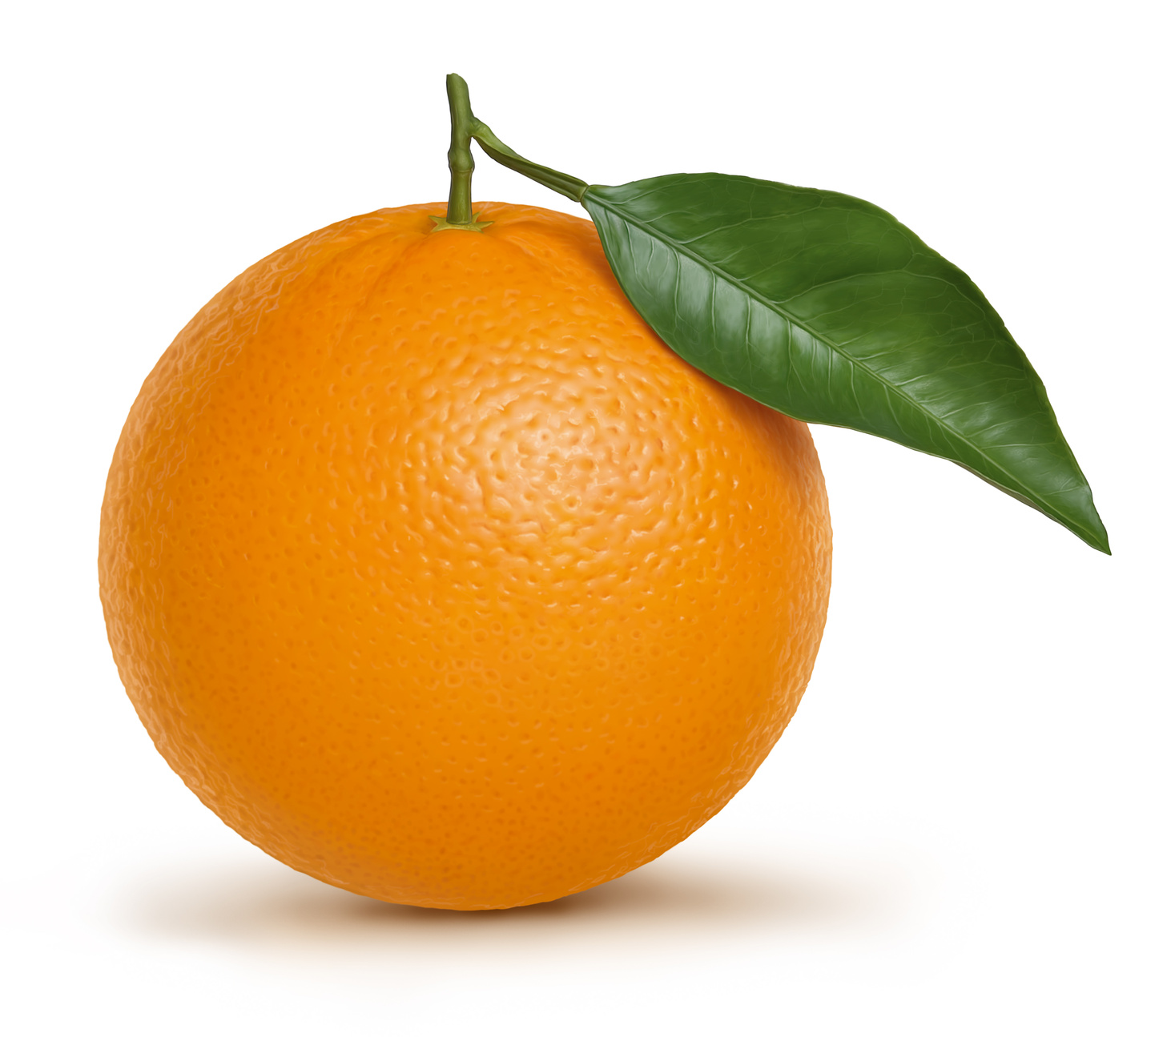
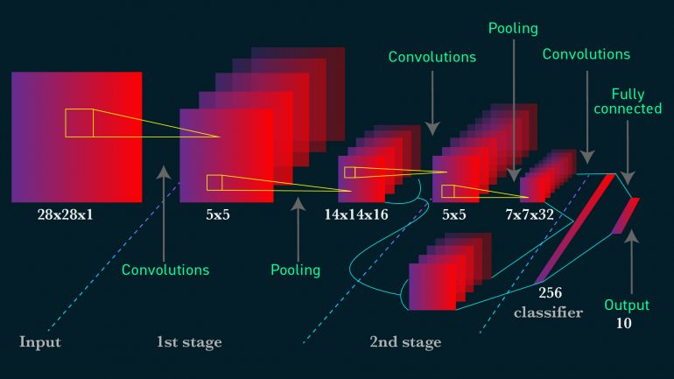
ANN model vs CNN Model
CNN MODEL
Only last layer is fully connected

Slide 17
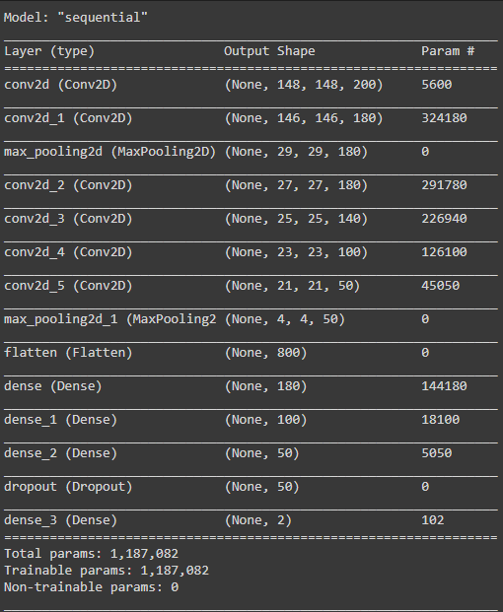
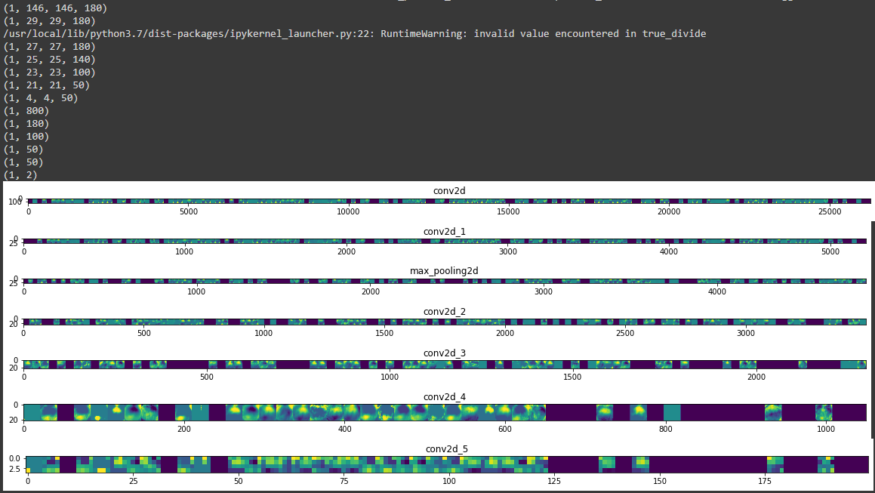
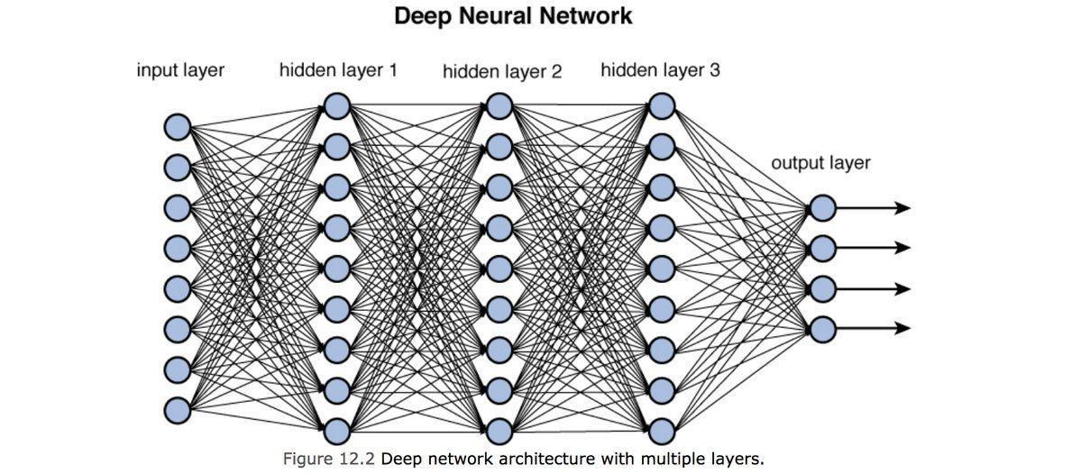
DEPTH OF CNN model

Slide 18
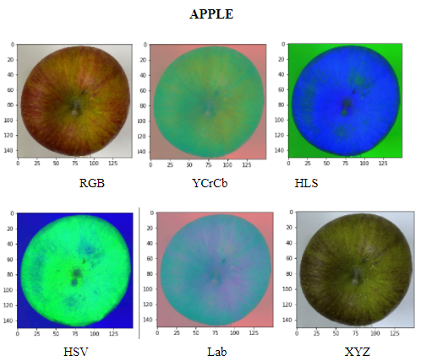
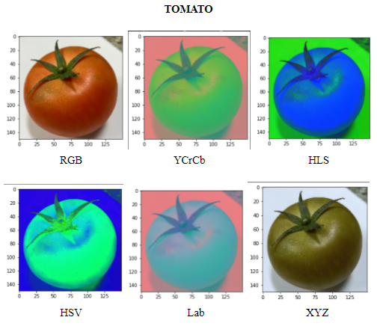
Color Space of fruit images
HSL
HSL

Slide 19
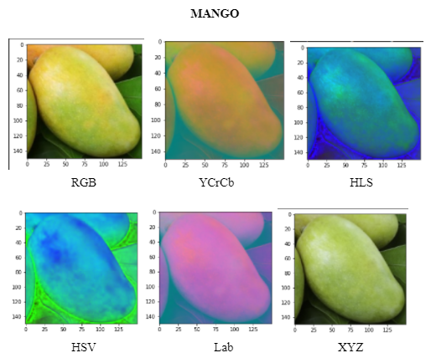
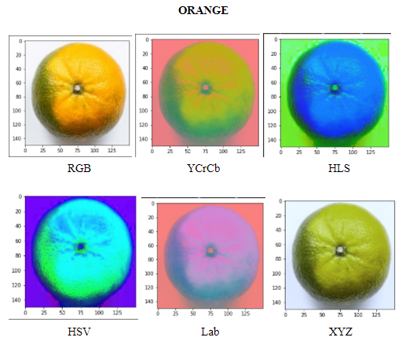
Color Space of fruit images
HSL
HSL

Slide 20
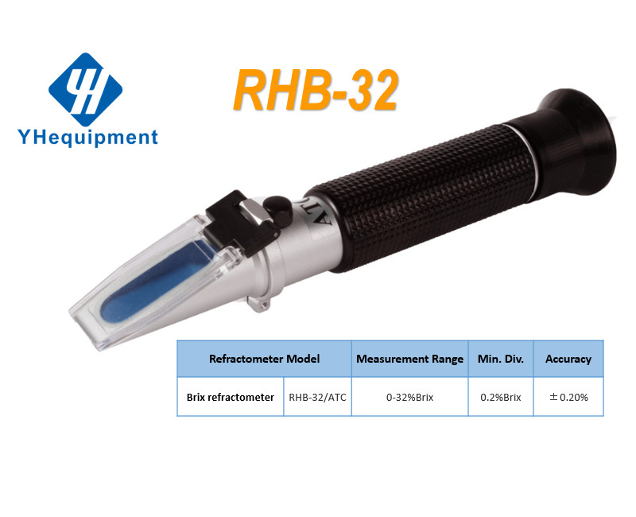
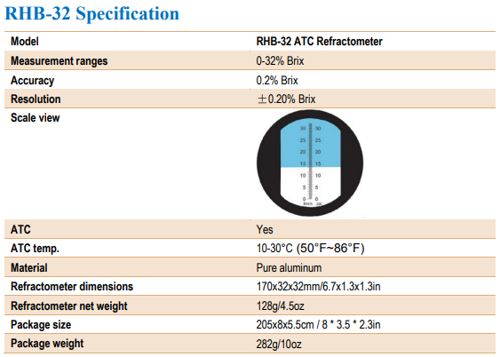
Ripeness model evaluation

Slide 21
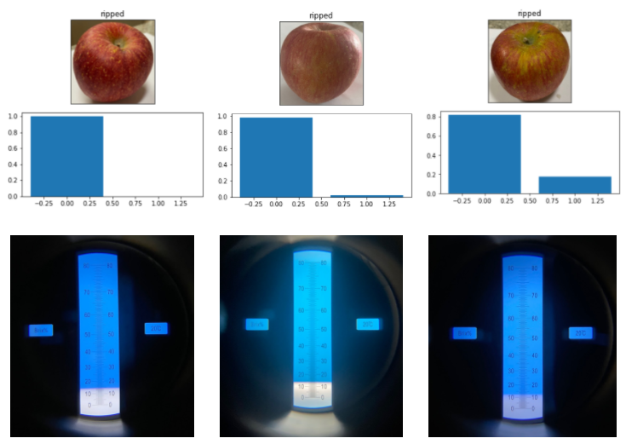
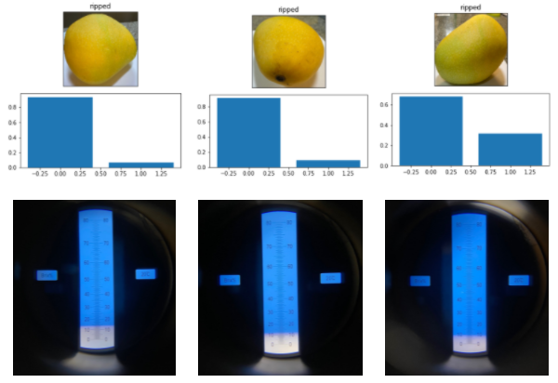
Ripeness model evaluation
ripe
unripe
ripe
unripe
ripe
unripe
ripe
unripe
ripe
unripe
ripe
unripe
~15
~14
~14
~11
~9
~12

Slide 22
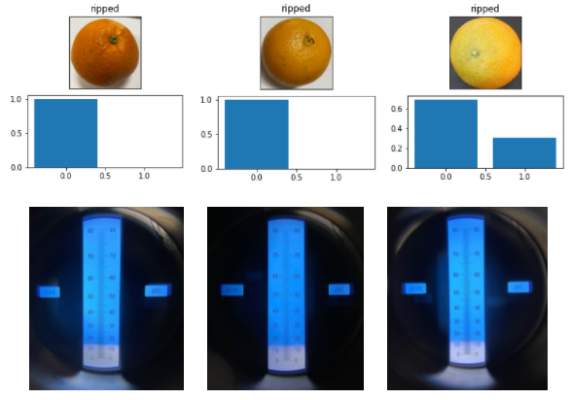
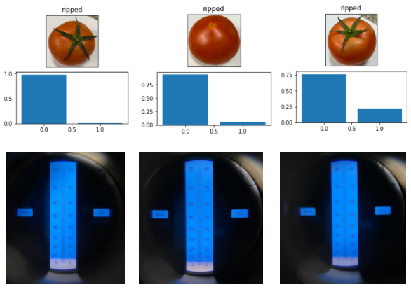
Ripeness model evaluation
ripe
unripe
ripe
unripe
ripe
unripe
ripe
unripe
ripe
unripe
ripe
unripe
~14
~14
~12
~6
~4
~4

Slide 23
Mobile
Application

Slide 24
Server
Creates Web Application (Server Hosting)
Hosts using Python Code
Easy for us to load our model and return ripeness score

Slide 25
SERVER
REST API:
POST Request that contains image RGB values
RIPENESS SCORE (%)

Slide 26


OBJEct DETECTION integration
INTEGRATION
YOLO

Slide 27
EXTracting bounding boxes from yolo model
Output of 2 arrays
[1, 13, 13, 45]
[1, 26, 26, 45]
13x13 grid image
For Larger Objects
26x26 grid image
For Smaller Objects
RESHAPE
RESHAPE
[13, 13, 3, 15]
[26, 26, 3, 15]

Slide 28
EXTracting bounding boxes from yolo model
0
1
2
3
4
5
6
7
8
9
10
11
12
13
14
X coordinate
Width
Height
Y coordinate
Objectness Score
Label Percentage

Slide 29
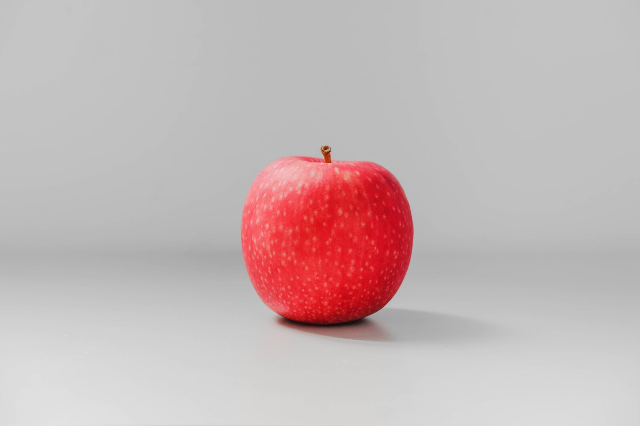
Non-maximum suppression
99%
94%
SUPPRESSED
93%
SUPPRESSED

Slide 30
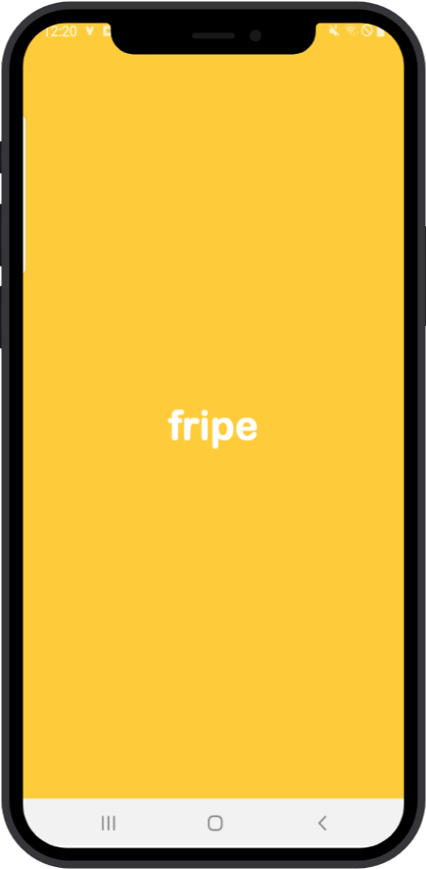
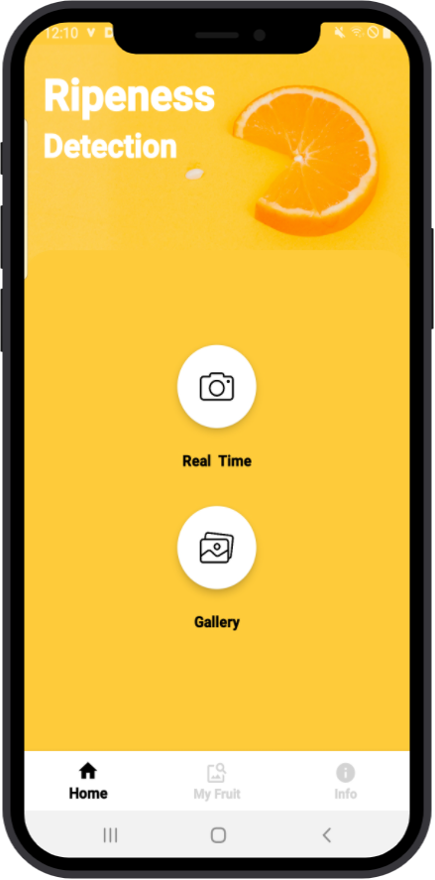
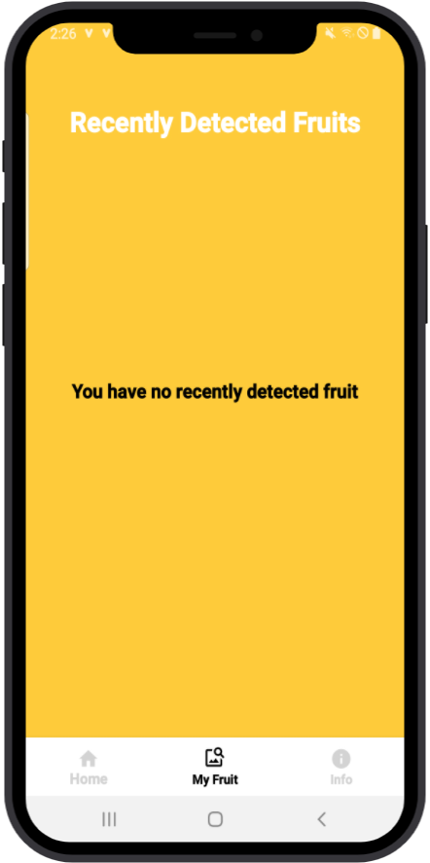
Application flow & ui
Splash Screen
Landing Page
My Fruit Page

Slide 31
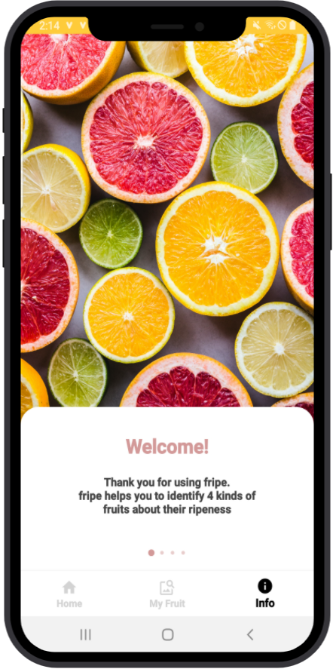
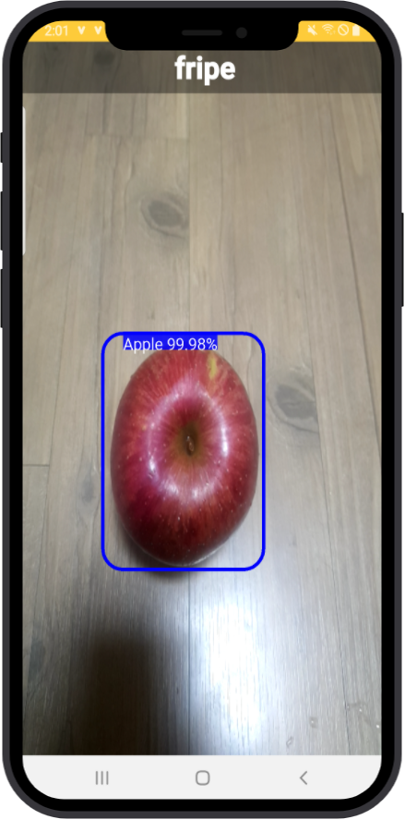
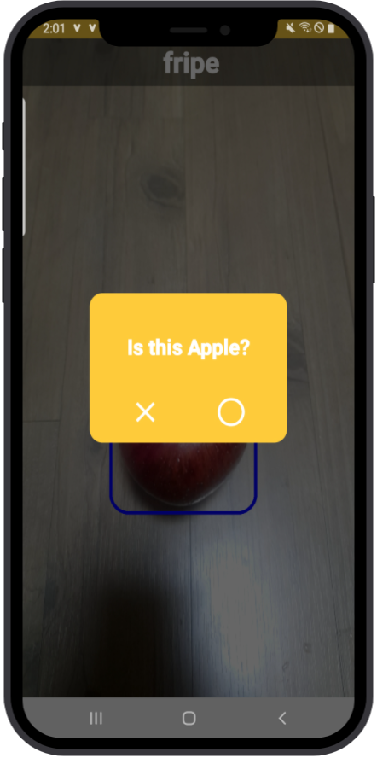
Application flow & ui
Info Page
Real Time Detection
Confirmation Dialog

Slide 32
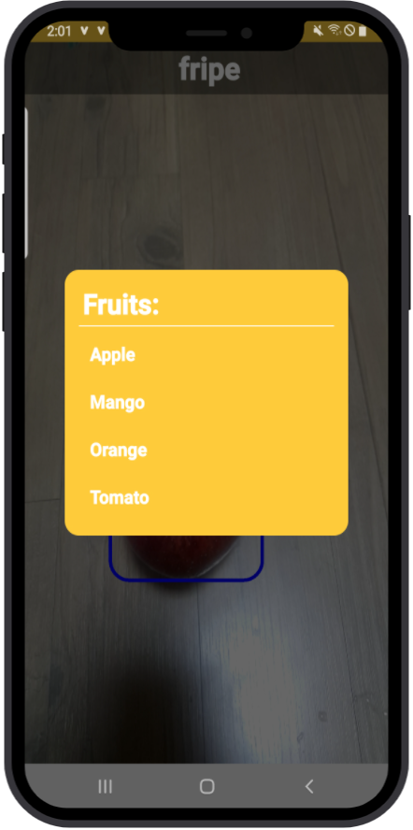
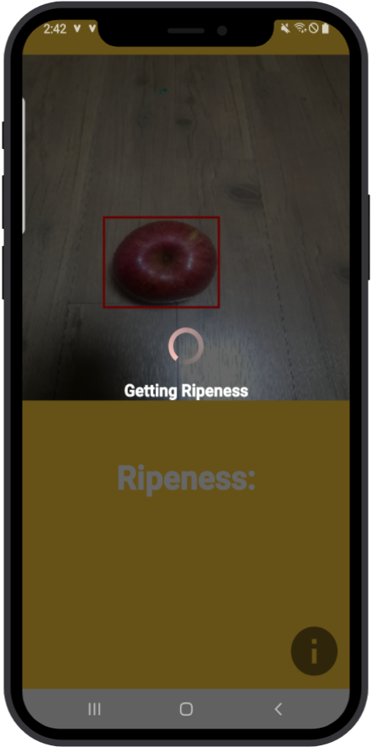
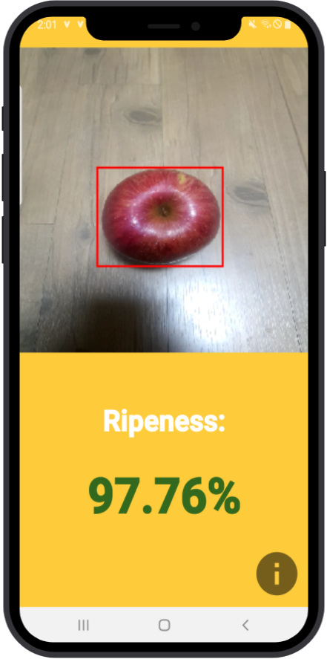
Application flow & ui
Select Fruit Dialog
Loading Page
Ripeness Page

Slide 33
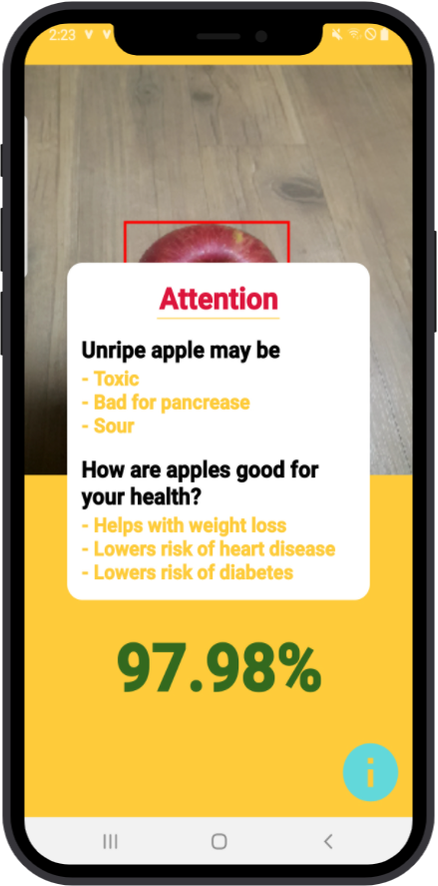
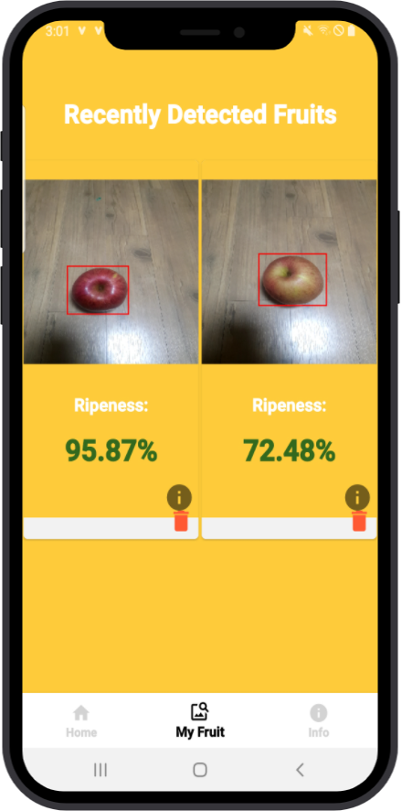

Application flow & ui
Attention Dialog
My Fruit Page
My Fruit Page

Slide 34



Application flow & ui
Select From Gallery
Select Fruit Dialog
Ripeness Page

Slide 35
Live demo

Slide 36
Object Detection + Tracking
Lack of Data
Light Sensitivity
Limitations & improvment

Slide 37
Conclusion + Q&A

Slide 38

ACKnowledgements
Professor Desmond Tsoi

